Slide 1

Fibonacci heaps
Dr. Anant Ram
Associate Professor
Dept. of CEA, GLA University, Mathura

Slide 2
Fibonacci heaps
Fibonacci heap is a collection of heap-ordered trees. The trees in a Fibonacci heap are not constrained to be binomial trees.
Fibonacci heaps are rooted but unordered.
Each node x contains a pointer p[x] to its parent and a pointer child[x] to any one of its children.
The children of x are linked together in a circular, doubly linked list , which we call the child list of x.
Each child y in a child list has pointers left[y] and right[y] that point to y's left and right siblings, respectively. If node y is an only child, then left[y] = right[y] = y.
Two other fields in each node will be of use. The number of children in the child list of node x is stored in degree[x]. The boolean-valued field mark[x] indicates whether node x has lost a child since the last time x was made the child of another node.

Slide 3
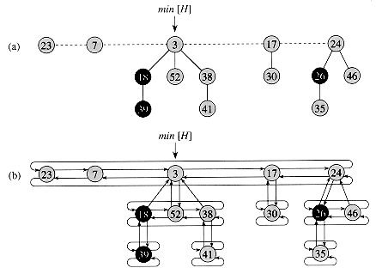
Fibonacci heaps

Slide 4
Operations on Fibonacci heaps
FIB-HEAP-INSERT(H, x)
1 degree[x] = 0
2 p[x] = NIL
3 child[x] = NIL
4 left[x] = x
5 right[x] = x
6 mark[x] = FALSE
7 concatenate the root list containing x with root list H
8 if min[H] = NIL or key[x] < key[min[H]]
9 then min[H] = x
10 n[H] = n[H] + 1

Slide 5
Fibonacci Heap Union
FIB-HEAP-UNION(H_{1,}H₂)
1 H MAKE-FIB-HEAP()
2 min[H] min[H₁]
3 concatenate the root list of H₂ with the root list of H
4 if (min[H₁] = NIL) or (min[H₂] NIL and min[H₂] < min[H₁])
5 then min[H] = min[H₂]
6 n[H] = n[H₁] + n[H₂]
7 free the objects H₁ and H₂
8 return H
FIB-HEAP-LINK(H, y, x)
1 remove y from the root list of H
2 make y a child of x, incrementing degree[x]
3 mark[y] = FALSE

Slide 6
Extracting the minimum Key
FIB-HEAP-EXTRACT-MIN(H)
1 z = min[H]
2 if z != NIL
3 then for each child x of z
4 do add x to the root list of H
5 p[x] = NIL
6 remove z from the root list of H
7 if z = right[z]
8 then min[H] = NIL
9 else min[H] = right[z]
10 CONSOLIDATE(H)
11 n[H] = n[H] - 1
12 return z

Slide 7
CONSOLIDATE(H)
1 for i = 0 to D(n[H])
2 do A[i] = NIL
3 for each node w in the root list of H
4 do x = w
5 d = degree[x]
6 while A[d] != NIL
7 do y = A[d]
8 if key[x] > key[y]
9 then exchange (x y)
10 FIB-HEAP-LINK(H,y,x)
11 A[d] = NIL
12 d = d + 1
13 A[d] = x
14 min[H] = NIL
15 for i = 0 to D(n[H])
16 do if A[i] != NIL
17 then add A[i] to the root list of H
18 if min[H] = NIL or key[A[i]] < key[min[H]]
19 then min[H] = A[i]

Slide 8
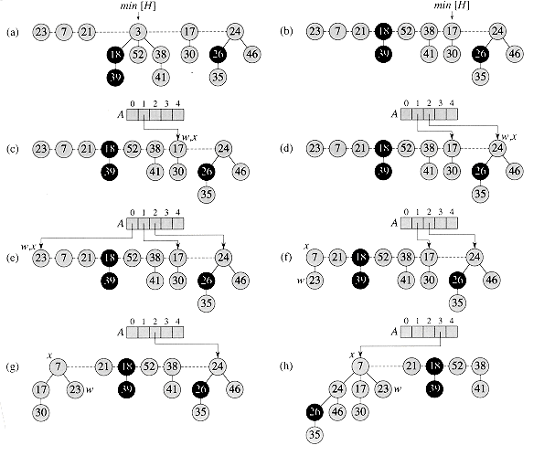

Slide 9
Decreasing a key and deleting a node Fibonacci Heap
FIB-HEAP-DECREASE-KEY(H,x,k)
1 if k > key[x]
then error "new key is greater than current key“
3 key[x]= k
4 y= p[x]
5 if y !=NIL and key[x] < key[y]
6 then CUT(H,x,y)
CASCADING-CUT(H,y)
8 if key[x] < key[min[H]]
9 then min[H]= x

Slide 10
Fibonacci Heap
CUT(H,x,y)
1 remove x from the child list of y, decrementing degree[y]
2 add x to the root list of H
3 p[x]= NIL
4 mark[x] = FALSE
CASCADING-CUT(H,y)
1 z= p[y]
2 if z!= NIL
3 then if mark[y] = FALSE
4 then mark[y] =TRUE
5 else CUT(H,y,z)
6 CASCADING-CUT(H,z)

Slide 11
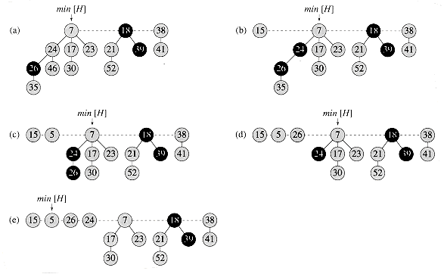

Slide 12
Deleting a node Fibonacci Heap
FIB-HEAP-DELETE(H, x)
1 FIB-HEAP-DECREASE-KEY(H, x, -∞)
2 FIB-HEAP-EXTRACT-MIN(H)

Slide 13
Amortized Cost Analysis
Potential function
Accounting Method
Aggregate Method

Slide 14
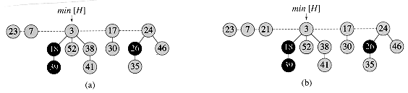
Φ(H) = t(H) + 2m(H)

